Slide 1


HEP NTUA Weekly Report 14/10/2020
George Bakas

Slide 2
Summary
Start investigating ttbar Systematic Uncertainties
Consistency checks with Giannis are done!
ttX round table
Top Angular Distributions: chi, |cosθ*| leading and subleading
Changed binning for the cos(θ*) distributions
Z’ analysis:
Production for Z’ (mass, width variations)
Files are now available for all years
AN 2020/156

Slide 3
Signal Selection
Control Region Selection
Variables | Selected Cut
pT (both leading jets) | > 400 GeV
Njets | > 1
N leptons | = 0
|eta| (both leading jets) | < 2.4
mJJ | > 1000 GeV
jetMassSoftDrop (only for fit) | (50,300) GeV
Top Tagger | > 0.2, 0, 0.1
B tagging (2 btagged jets) | > Medium WP
Signal Trigger
Variables | Selected Cut
pT (both leading jets) | > 400 GeV
Njets | > 1
N leptons | = 0
|eta| (both leading jets) | < 2.4
mJJ | > 1000 GeV
jetMassSoftDrop (only for fit) | (50,300) GeV
Top Tagger | > 0.2, 0, 0.1
B tagging (0 btagged jets) | < Medium WP
Control Trigger

Slide 4
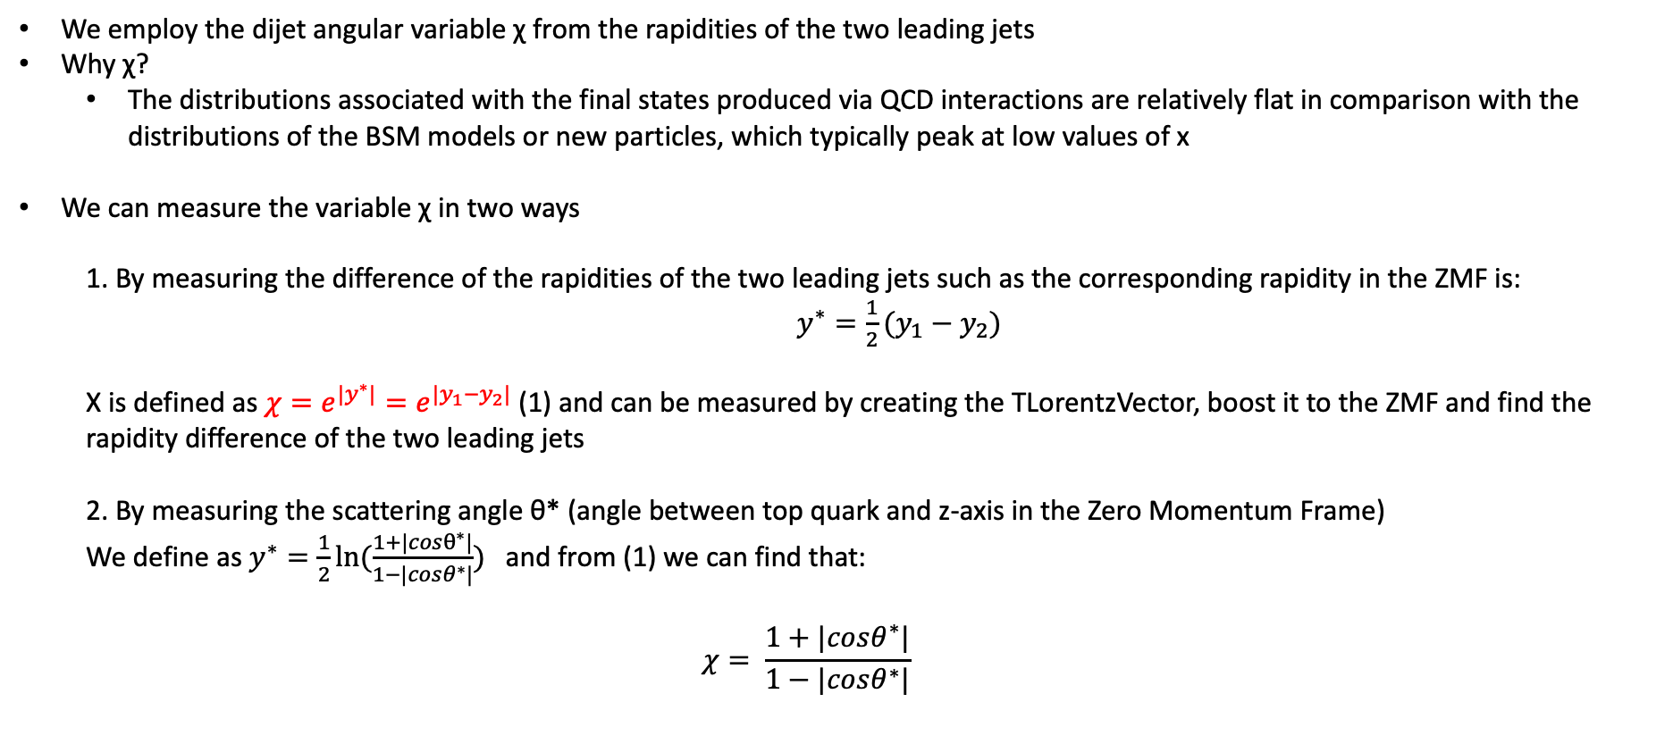
Top Angular Distributions
We employ the dijet angular variable χ from the rapidities of the two leading jets
Why χ?
The distributions associated with the final states produced via QCD interactions are relatively flat in comparison with the distributions of the BSM models or new particles, which typically peak at low values of x
We can measure the variable χ in two ways
1. By measuring the difference of the rapidities of the two leading jets such as the corresponding rapidity in the ZMF is: $y^{∗}=\frac{1}{2}(y_{1}−y_{2})$
Χ is defined as $χ=e^{{|y}^{∗}|}=e^{|y_{1}−y_{2}|}$ (1) and can be measured by creating the TLorentzVector, boost it to the ZMF and find the rapidity difference of the two leading jets
2. By measuring the scattering angle θ* (angle between top quark and z-axis in the Zero Momentum Frame)
We define as $y^{∗}=\frac{1}{2}ln⁡(\frac{1+|cosθ^{∗}|}{1−|cosθ^{∗}|})$ and from (1) we can find that:
$$χ= \frac{1+|cosθ^{∗}|}{1−|cosθ^{∗}|}$$

Slide 5
Search for top-antitop resonances
Numerous extensions of the SM predict the existence of new interactions with enhanced couplings to third generation quarks, especially the top quark
The associated new particle→observation as a ttbar resonance
Examples of such resonances:
Massive Color-singlet Z like bosons (Z’)
Colorons
Axigluons
Heavier Higgs siblings
Kaluza-Klein excitations of gluons
Electroweak gauge bosons
Gravitons in various extensions of the Randall-Sundrum model
All of the above predict the existence of TeV-scale resonances with a cross section of a few pb’s
Resonant ttbar production would be observable in the reconstructed invariant mass of the ttbar system
Most analyses search for peaks in the invariant ttbar mass

Slide 6
Response Matrices

Slide 7
Response Matrices

Slide 8
Signal Extraction
Fitted number of QCD events in SR_{A}
Measured dist from data
QCD shape taken from Data (CR)
$$S\left(x_{reco}\right)=D\left(x_{reco}\right)−C_{bkg}^{yield}N_{QCD}^{fit}\left(x_{reco}\right)Q\left(x_{reco}\right)−B(x_{reco})$$
Fiducial Yield
Transfer factor from SR_{A} to SR
Subdominant bkg shape and contribution (MC)
Where x_{reco} is the respected variable of interest (ttbar mass, pt, rapidity, leading and subleading jetPt and |jetY|)
We deploy a fit in the Signal Region (2btag) to extract the $N_{QCD}^{fit}$
$$D{\left(m^{t}\right)}^{(i)}=N_{tt}^{(i)}T^{(i)}\left(m^{t},k_{MassScale}, k_{MassResolution}\right)+N_{bkg}^{(i)}B\left(m^{t} \right)\left(1+k_{1}x\right)+N_{sub}^{(i)}O^{(i)}\left(m^{t}\right)$$
Our data CR is contaminated from ttbar and subdominant bkgs which has to be dealt with.

Slide 9
Fiducial Measurement
(2016)
(2016)

Slide 10
Fiducial Measurement
(2016)
(2016)

Slide 11
Parton Measurement
(2016)
(2016)

Slide 12
Parton Measurement
(2016)
(2016)

